Slide 1
Defining
principles

Slide 2
How to make a definition?
Issue/device/idea/concept
Not isolated, but belongs to a larger group with which shares features
What distinguishes our item from its group are its specific characteristics

Slide 3
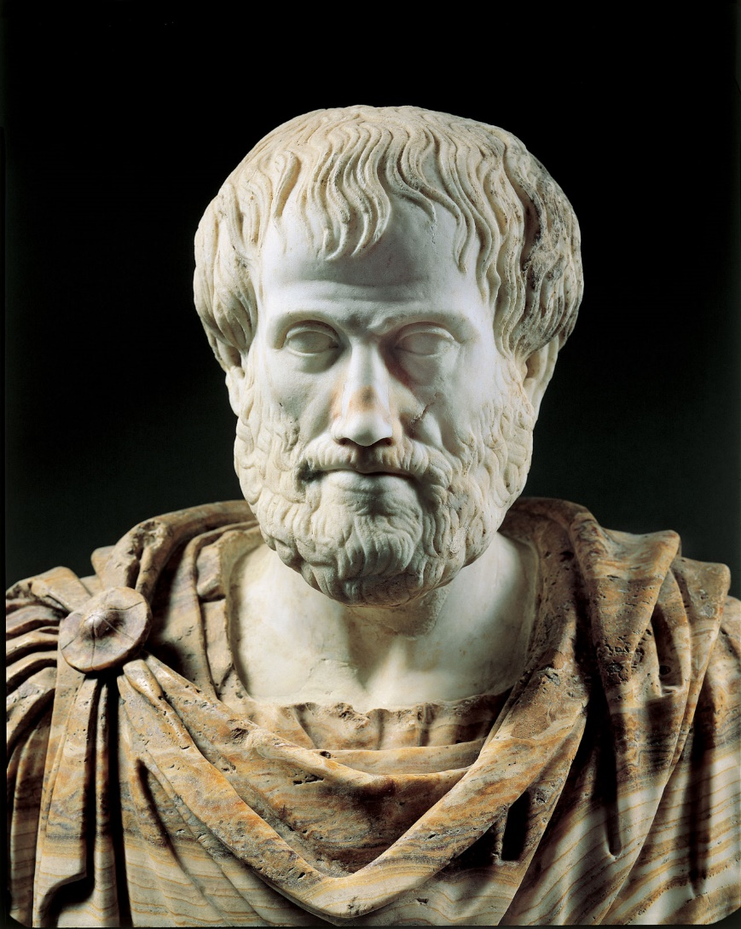
Aristotle

Slide 4

Tool for thought

Slide 5
Formula
Item A belongs to the group of items B and it can do/be used for smth in particular.

Slide 6
Examples
What is a faculty?
A faculty is an educational institution that educates students for their future profession.
What is software?
Hardware?
Application?
Generator?
Network?
Robot?

